Slide 1
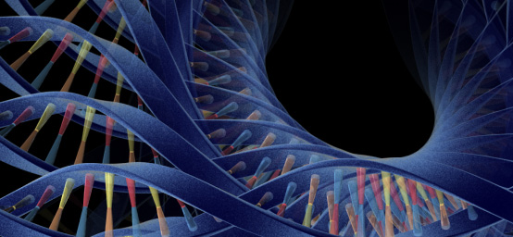
Using Dynamic Displays to Maximize the Value of Data
New Jersey Chapter of the American Statistical Association
Karine Badou, Allison Florance, Kattayoun Kordy, Baldur Magnuson, Xiao Ni, Marc Vandemeulebroecke, Andrew Wright and
Douglas Robinson, PhD, Global Head of Biomarkers and Diagnostics Biometrics + Advanced Visual Analytics Lead
June 29, 2018

Slide 2
Disclaimer
This presentation is based on publicly available information (including data relating to non-Novartis products or approaches)
Any data relating to Novartis products have been either anonymized or simulated to represent actual data
The views presented are the views of the presenter, not necessarily those of Novartis
These slides are intended for educational purposes only and for the personal use of the audience
The content of this slide deck is accurate to the best of the presenter’s knowledge at the time of production

Slide 3
Outline
Role of the statistician...at Novartis
Statistics in Pharma and why things have to change
The Graphics Principles Cheat Sheet
Dynamic Displays using R – Shiny
Conclusion

Slide 4
Role of the statistician...at Novartis
What a great time to be a statistician!!
  Being just a statistician is not enough...
We owe it to ourselves to dig in and truly...
  Understand the problem fully; e.g. disease and mechanism of action
  Listen carefully to our collaborators; Openly ask questions to clarify
  Communicate across teams, boundaries, time zones
  Collaborate effectively and constantly network
  Take time to sit and really think; if necessary, iterate the above steps
We need to understand generation of our data
  Technology
  Sample / data handling, pre – processing, normalization
  Sources of variability
  Gives us a measure of confidence in the data

Slide 5
Need to be Statistical Leaders
Often, our stakeholders see us simply as number crunchers
Statistical leadership is the key to deepening our value and visibility
We must collaborate and effectively communicate within multidisciplinary matrix teams are key to bright and sustainable future
  Multidisciplinary research teams are a network of relationships that are not hierarchical in nature.
Statistical leaders influence without authority and employ leadership regardless of seniority or perceived place in a hierarchy
To be successful requires...
  Sound statistical training
  A willingness to speak up and share ideas
  Ability to make clear, concise and persuasive recommendations
  Earn and build trust in ourselves and in those around us

Slide 6
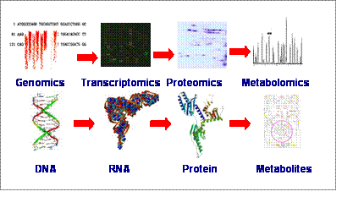
Statistics in Pharma and why things have to change
The world is rapidly changing
  Healthcare and pharmaceutical
Led by dramatic advances / innovations in technology
  Massive amounts of data
  Generating more with less
Oncology leveraging biomarkers
  Next Generation Sequencing
  RNA – Sequencing
  Protein profiling
  Flow cytometry
But what is next?
  Metabolomics
  Epigenetics?

Slide 7
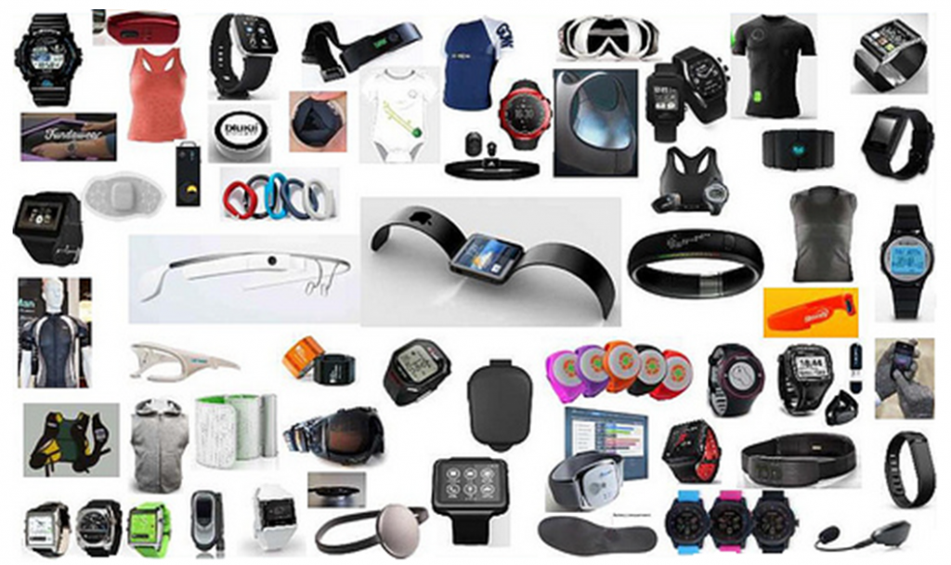
Greater integration of man and machine
...No, not like the Robocop, the Terminator or Darth Vader
Wearable technology, continuous monitoring devices, blue tooth
  Gaming devices passively track movement; leveraging cell phones
Future(?) = Implantable devices, “smart” pills, etc.

Slide 8
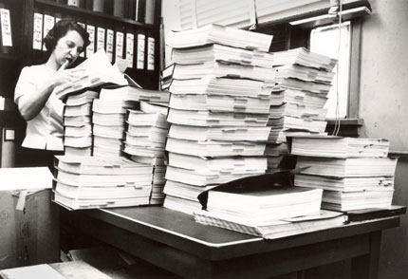
Statistics in Pharma and why things have to change
Teams pre-plan 100s of Tables, Listings and Figures in studies
  Regardless of value
  Static output in SAS
Generate 1000s of formatted output for submission plus 1000s more for Ad Comms
Problem Statement:
We try to cover all possibilities
  Requires heavy resources, yet many (most) not even referenced in study reports
Trials show unexpected results
  Must go back and produce even more output

Slide 9
What can be done about this?
At Novartis we formed the Advanced Visual Analytics Initiative:
  Enhance understanding with use of good graphical principles
  Promote up front graphical thinking
  Facilitate easy access to high quality graphics
  Provide state-of-the-art ideas on graphical presentation of data for exploratory analyses
How does one get there?
  How does one tell a good graph from a bad one?
  How does one design a good graph that is fit for purpose?
  Education on the true meaning of good graphical principles

Slide 10
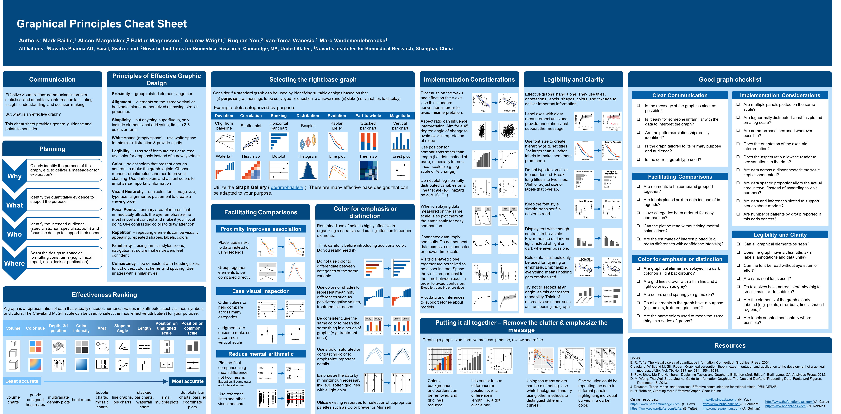
Introducing the Graphical Principles Cheat Sheet!!

Slide 11
Using the Cheat Sheet during design and planning
Effective visualizations communicate complex information in easily digestible manner
  Facilitate insight and understanding
  Facilitate decision making
If at first you don’t succeed...
  Don’t settle for just ok
  Allow your data speak for itself
  Put as much effort into presentation as your analysis
    Impressions matter...
Why
  Clearly identify the purpose of the graph, e.g. to deliver a message or for exploration?
What
  Identify the quantitative evidence to support the purpose
Who
  Identify the intended audience (specialists, non-specialists, both) and focus the design to support their needs
Where
  Adapt the design to space or formatting constraints (e.g. clinical report, slide deck or publication)

Slide 12
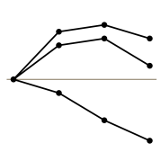
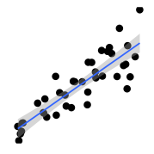
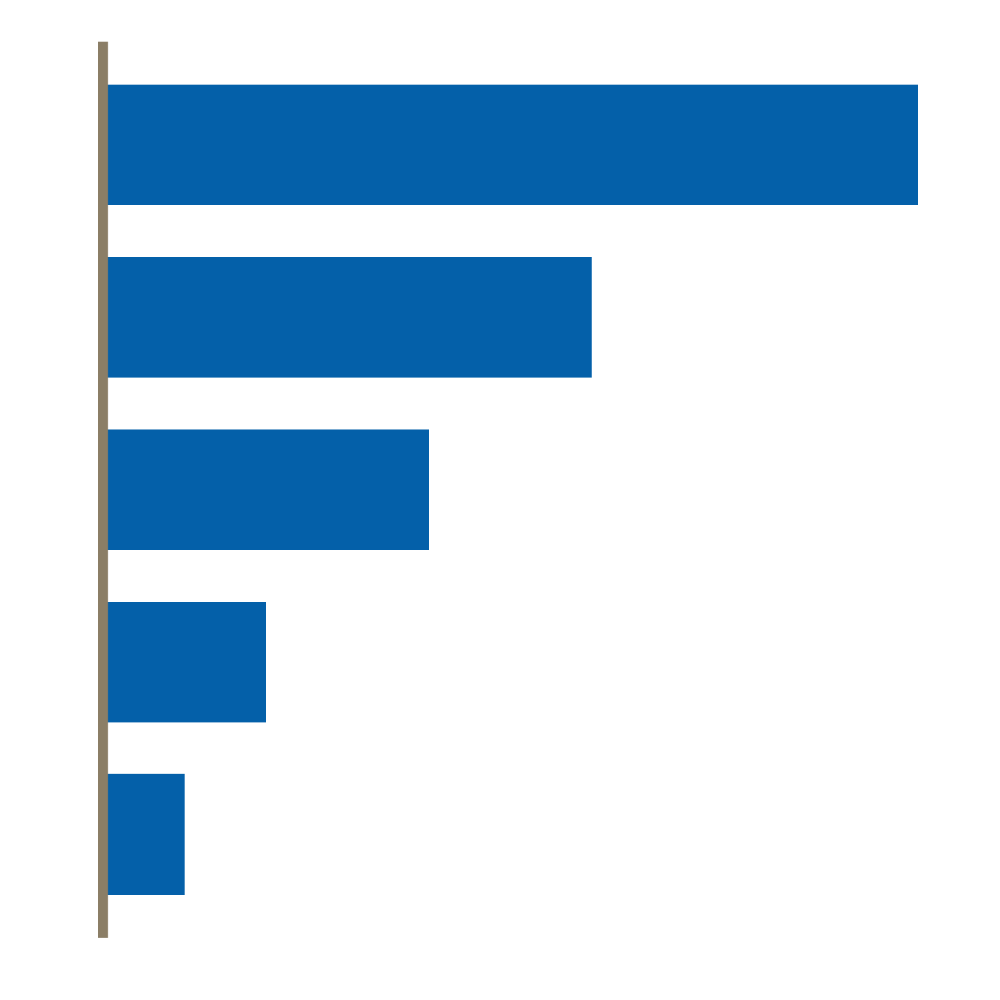
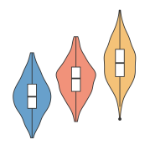
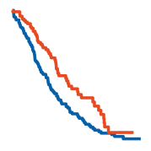
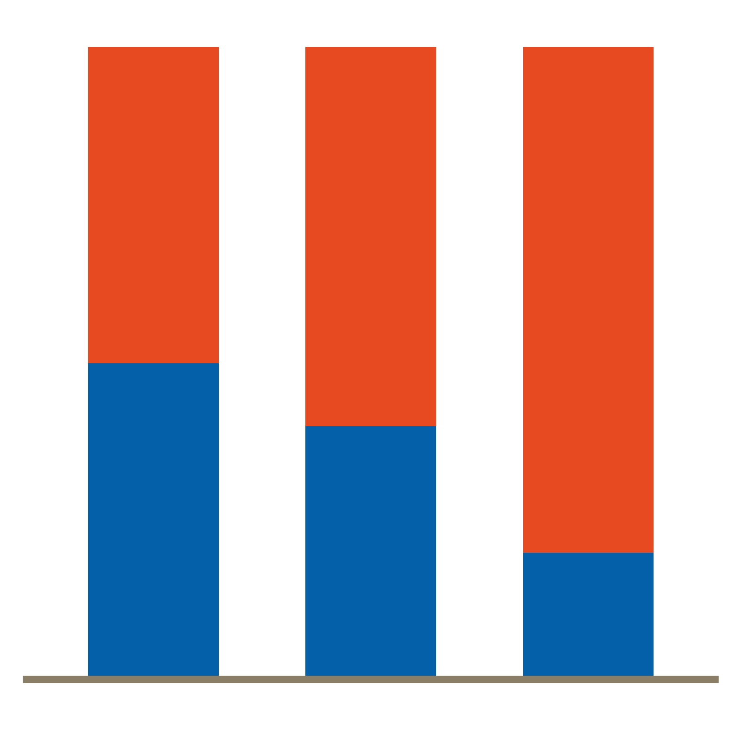
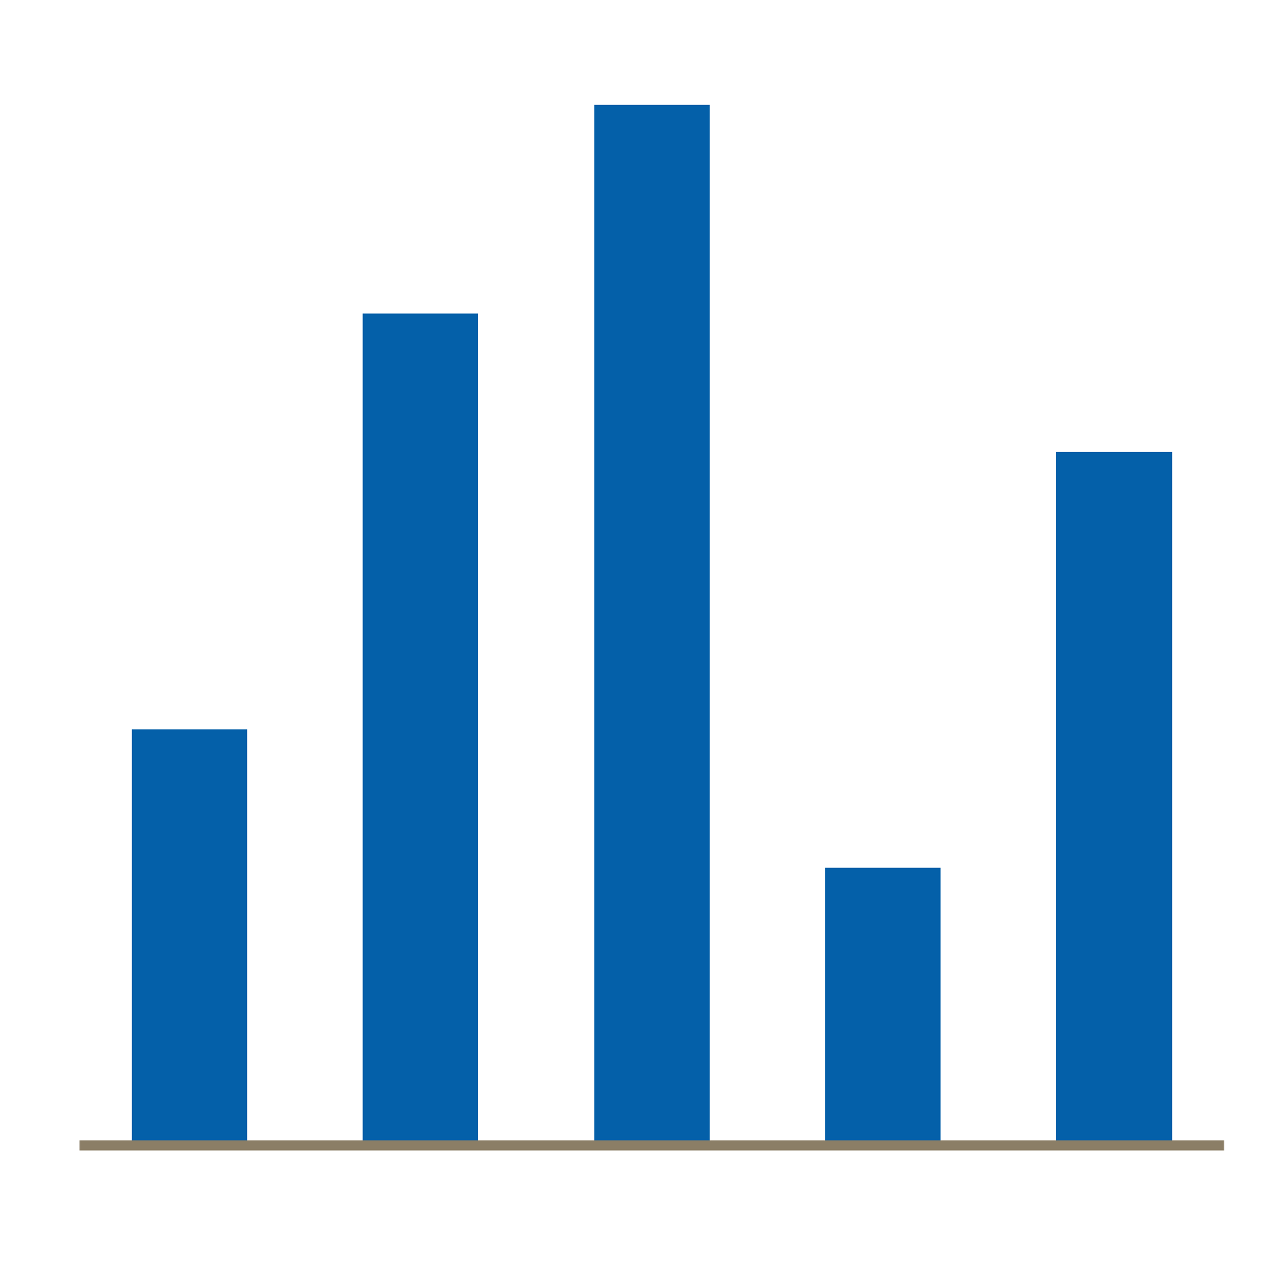
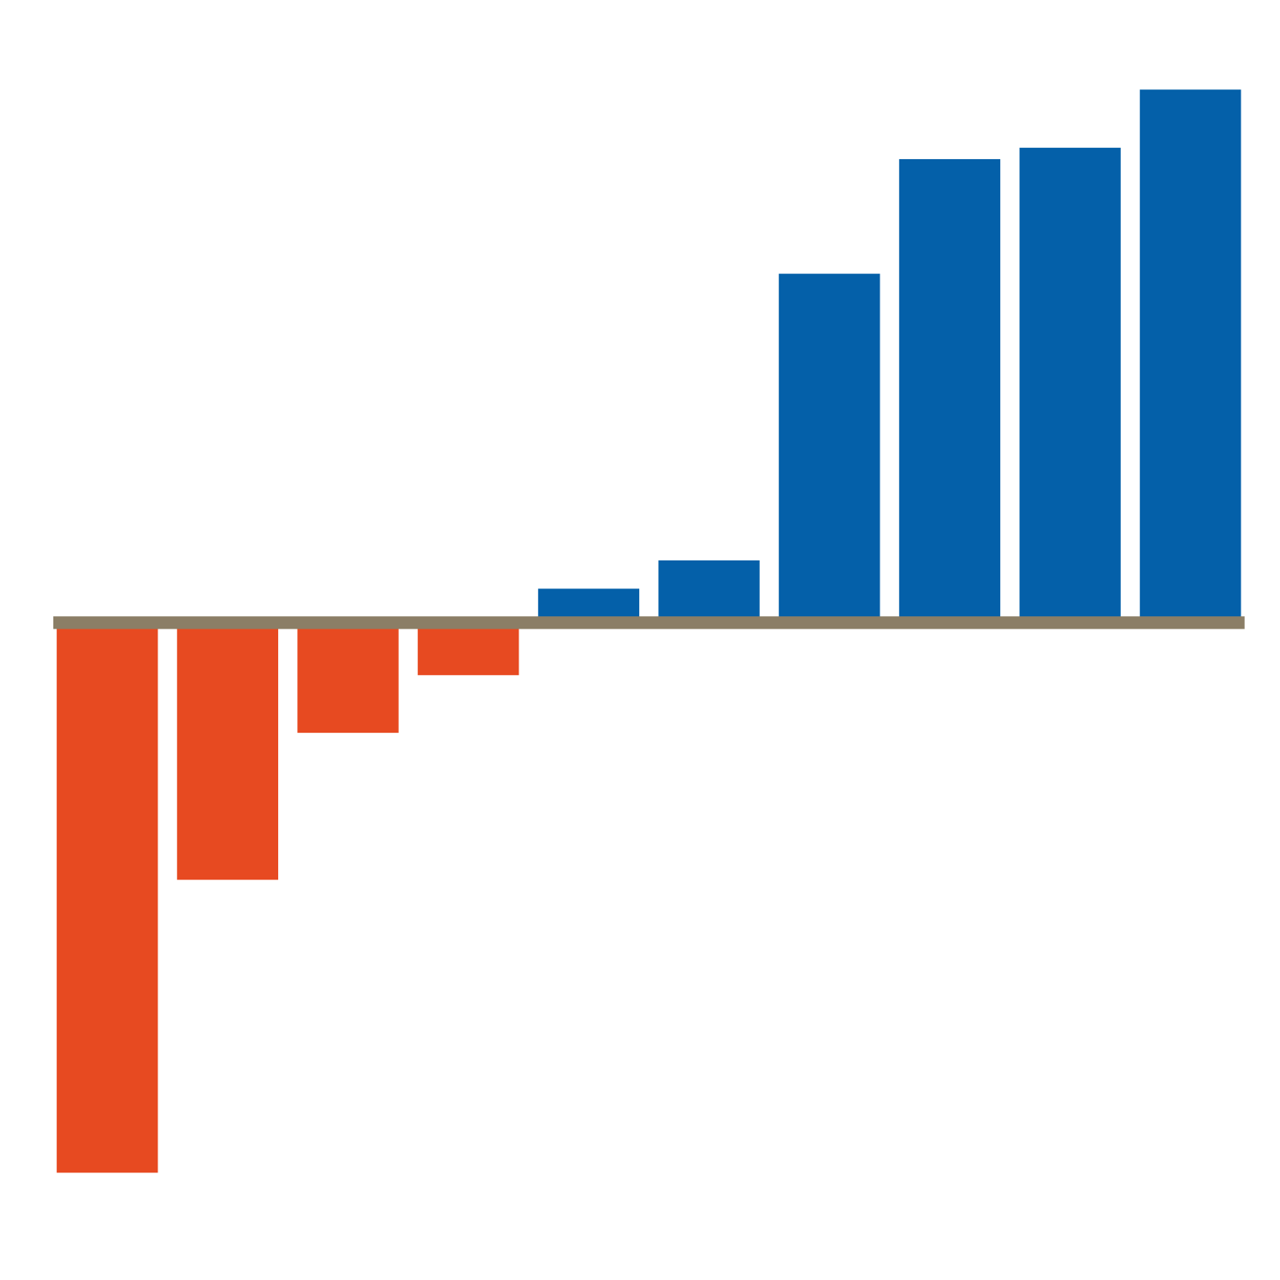
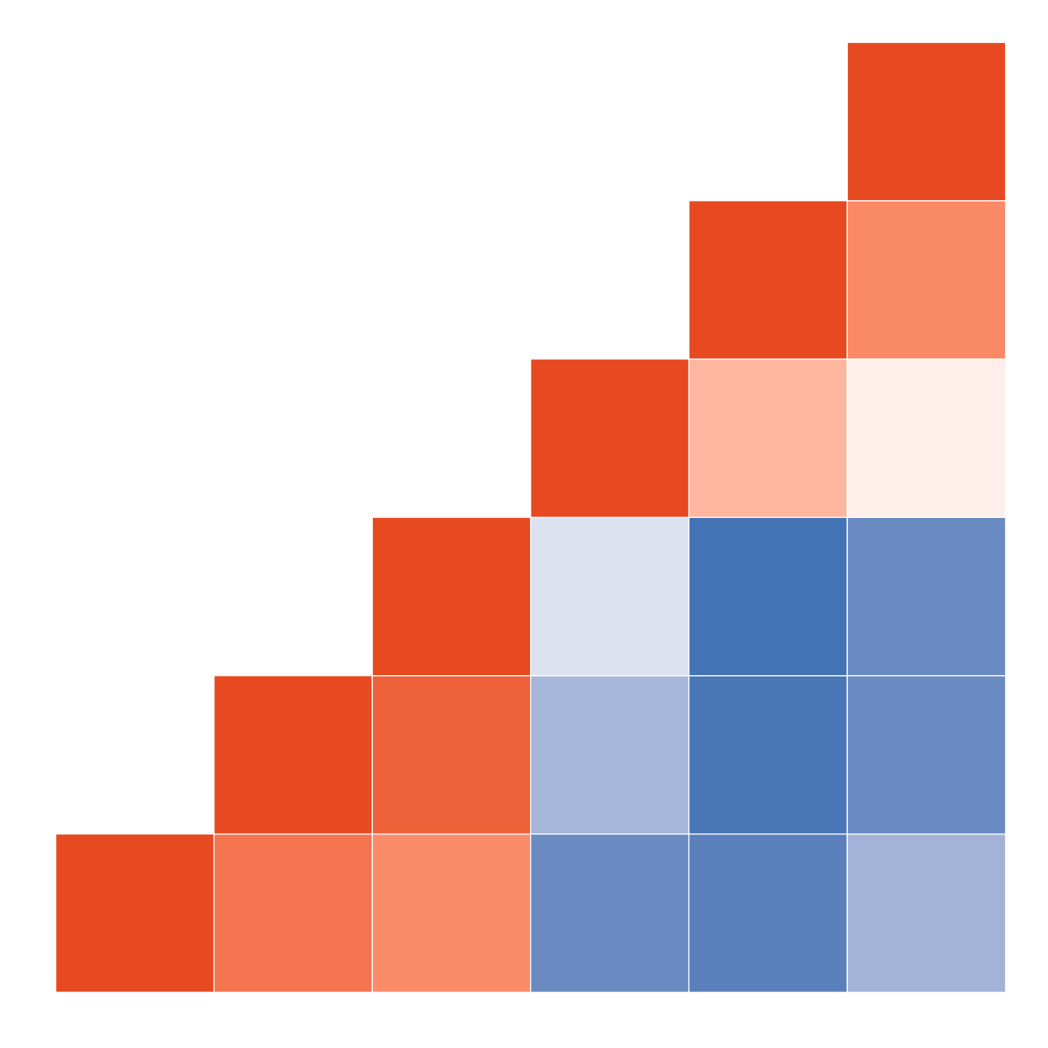
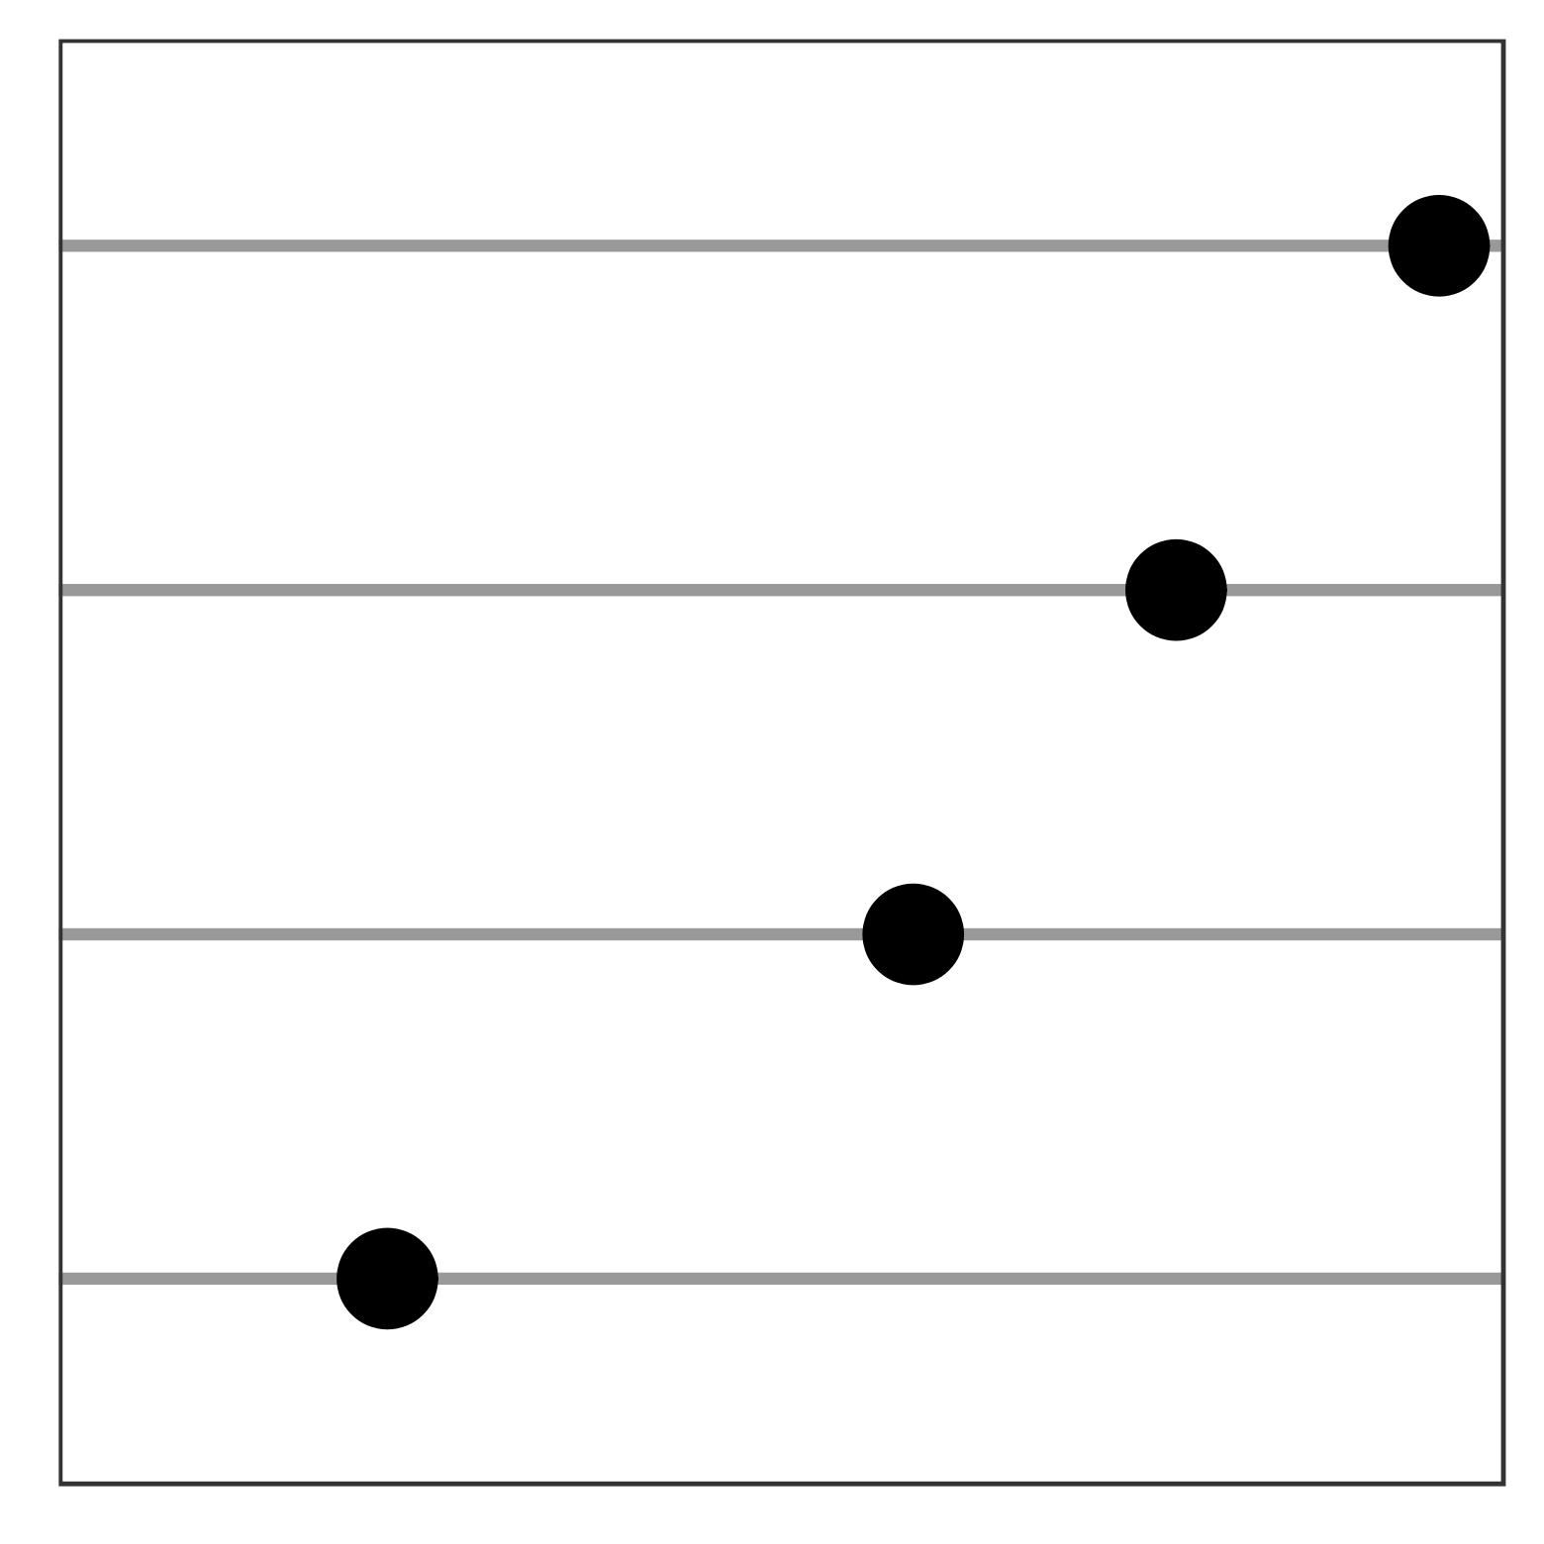
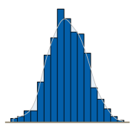
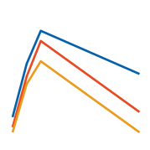
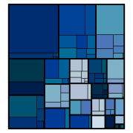
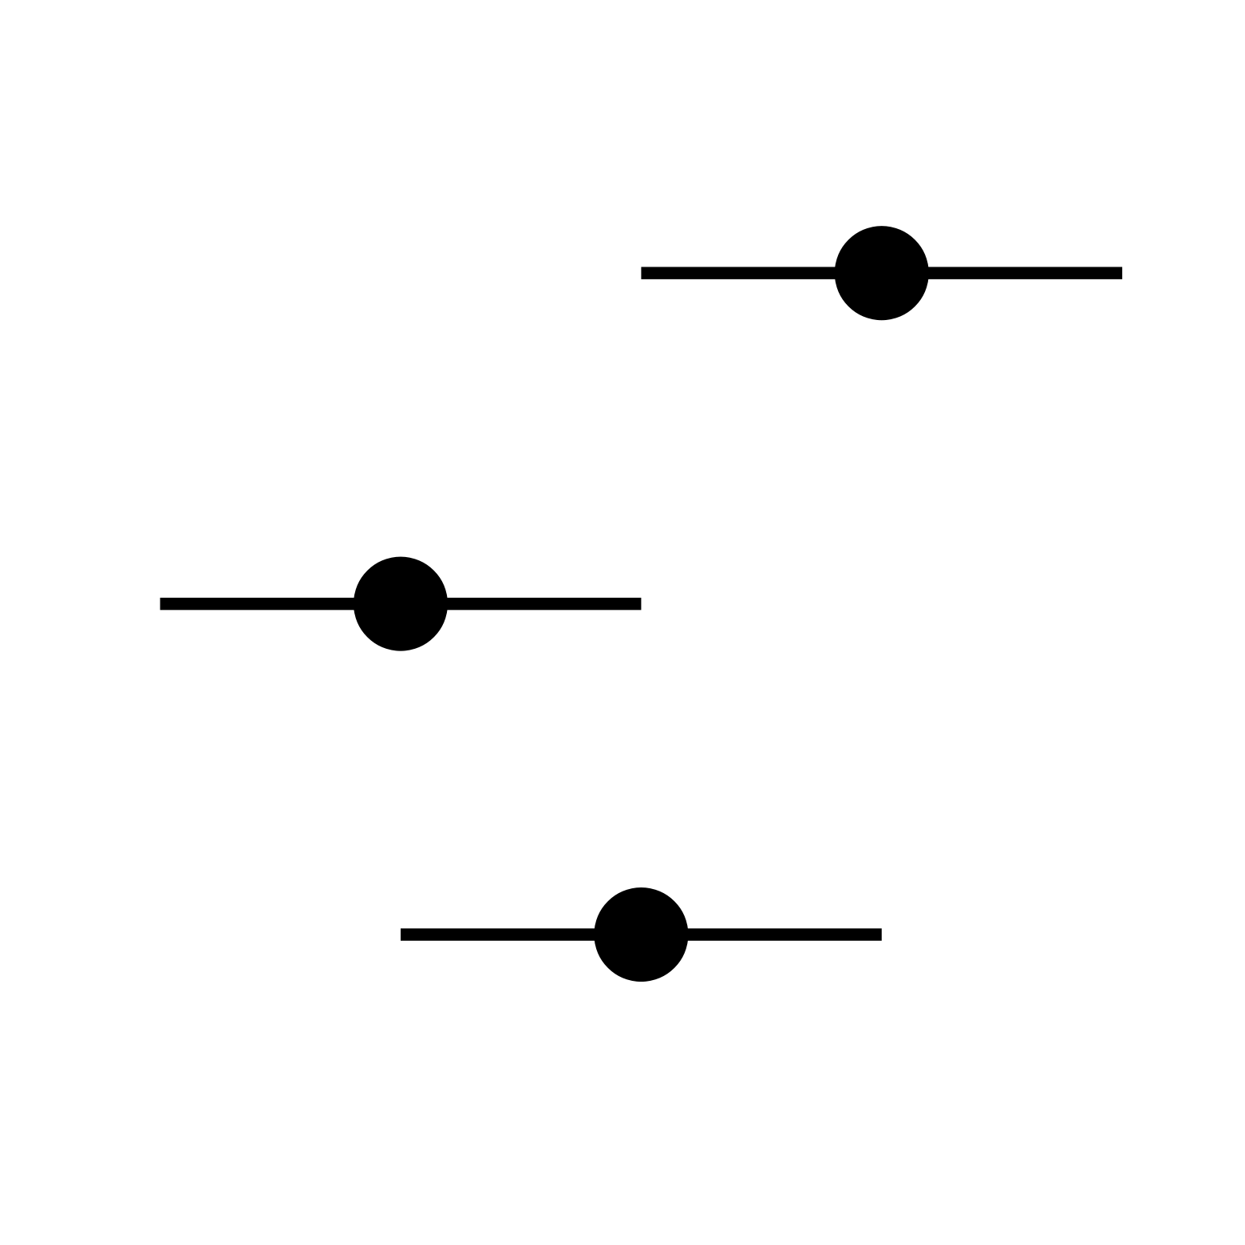
Choosing the Correct Graph Type Aids Interpretation
Deviation | Correlation | Ranking | Distribution | Evolution | Part-to-whole | Magnitude
Chg. from baseline | Scatter plot | Horizontal bar chart | Boxplot | Kaplan Meier | Stacked bar chart | Vertical bar chart
Waterfall | Heat map | Dotplot | Histogram | Line plot | Tree map | Forest plot
Carefully consider your data and question being asked
Strive for simplicity to maximize the value of your data
Take time to review front and back and we encourage you to explore
Good graphical principles also apply to dynamic graphs as well

Slide 13
Dynamic Displays Using R - Shiny
R – Shiny is a free package that implements dynamic displays of data
Web user interface built in R language
  No HTML, CSS or JavaScript knowledge required in order to use R – Shiny
Consists of two main files
  server.R = R code for data formatting / analytics / graphics
    Run code based on user defined input
    Ability to rerun code the instant a user makes an update
    Ability to access HPCE to run intensive simulations, if desired
  ui.R = implements the user interface portion
    Text boxes, slider bars, check boxes, radio buttons, drop down menus
    Data selection tools
    Ability to hover over points and see patient specific metadata
With high external innovation; limited only by our own imagination

Slide 14
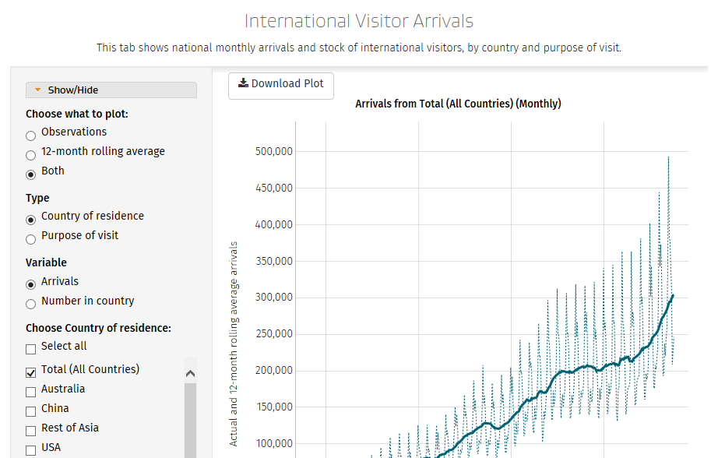
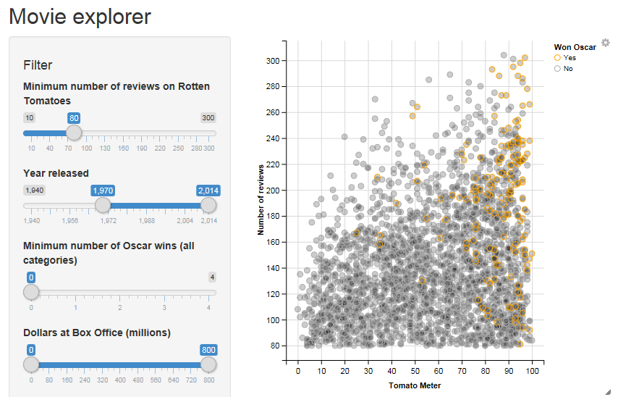
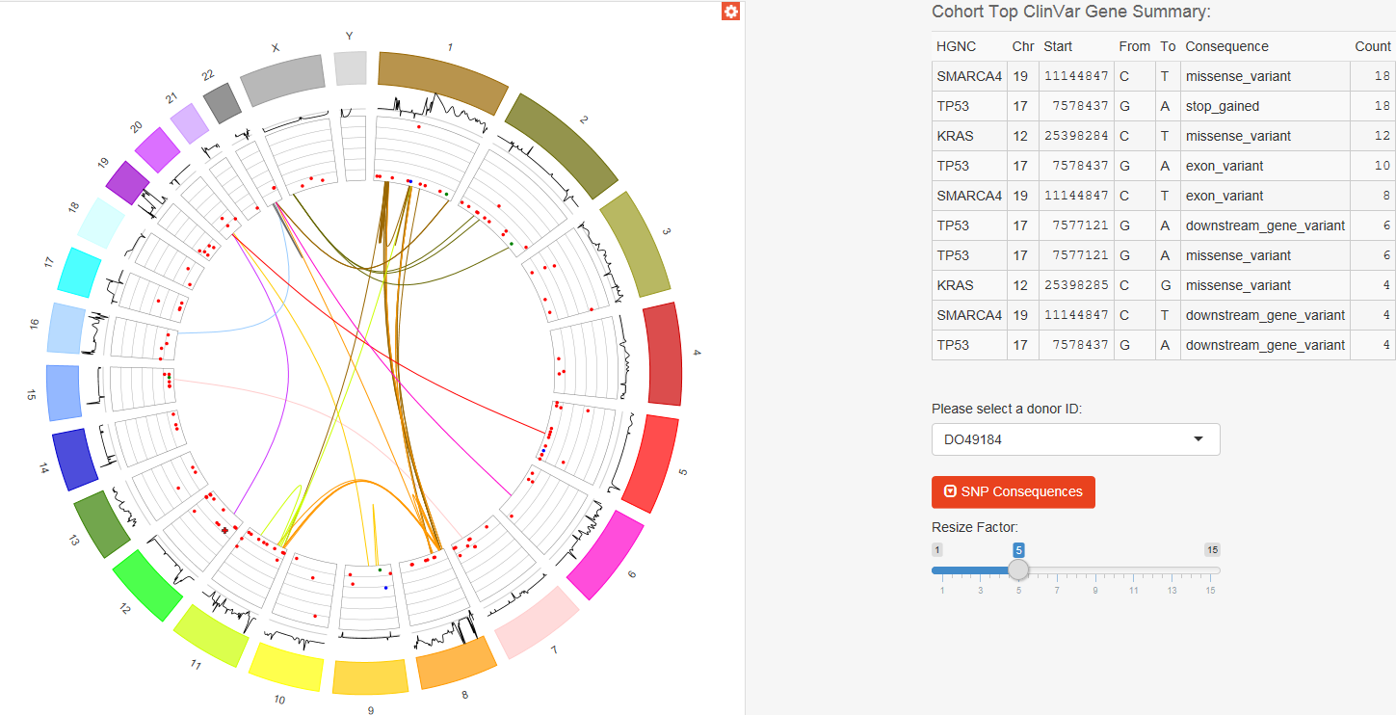
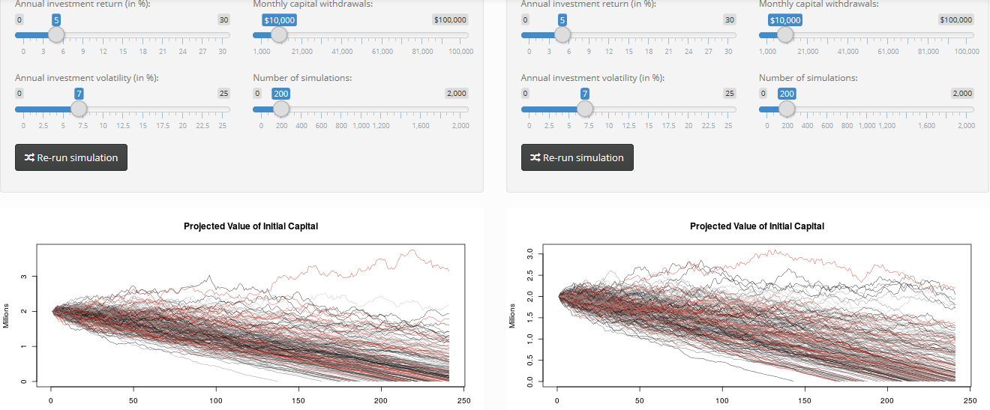
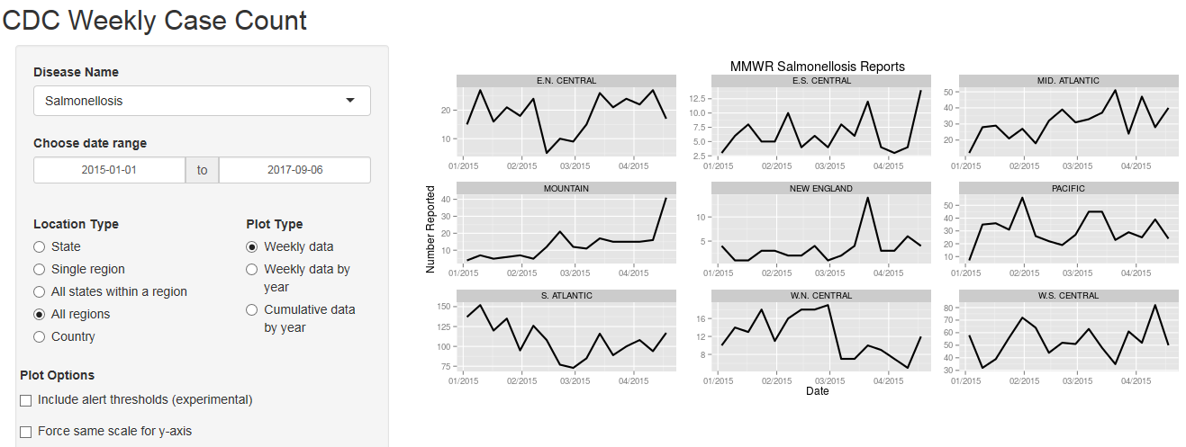
So...What is out there? (https://shiny.rstudio.com/gallery/)

Slide 15
Dynamic Displays Using R - Shiny
At Novartis, Statisticians and Pharmacometricians are embracing R – Shiny and are having fun building Apps for their studies
Formed a team named Advanced Visual Analytics
  Gather like minded analysts to discuss benefits and opportunities
  Build infrastructure to capture work in this area
  Develop educational material to train others
  Central document repository and communicate success stories
  Align on vision for the future and strategy to get there
Exciting journey that is only picking up momentum
  Giving presentations across the company
    Including time with the CEO and Board of Directors
  Sharing work with project teams and planning how to scale
  Considering cross company initiative to discuss with FDA

Slide 16
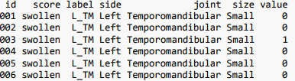
Dynamic Displays @ Novartis
Credit: David James, Xuan Zhu, Greg Ligozio, Xiao Ni
One of our compounds focuses on alleviating joint swelling
  Patients are measured at ~70 different joint positions and are assessed as to whether there is swelling or not
    Data are essentially “position”, “1,0 = Yes / No”
    Data are taken at baseline, Week 8 and Week 16
      Total of ~210 measurements per patient
    Patients score by adding up all positions with swelling
  3.1 GB of data!! Thousands of rows of data...

Slide 17
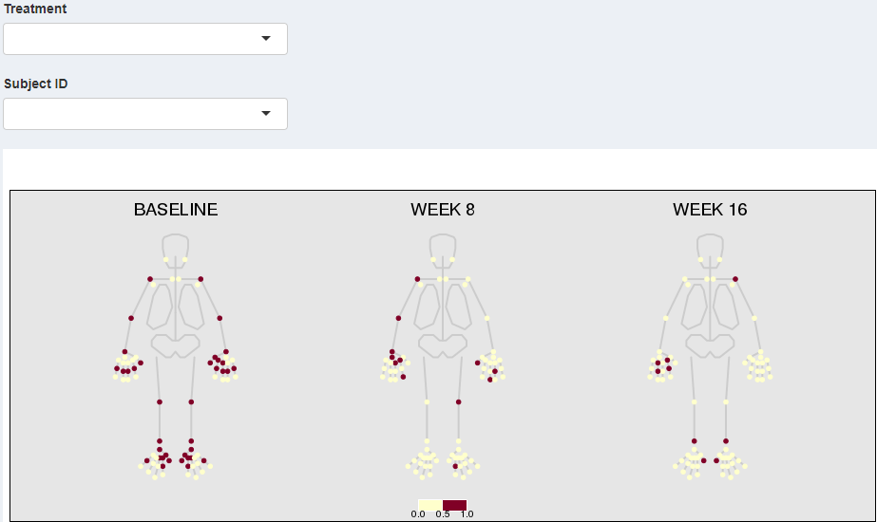
Dynamic Displays @ Novartis
Each data point is accurately placed on human figure
Dark colored as to whether there is swelling = YES
Can easily change treatment arm and click through all patients
  This one patient would be > 7 page listing

Slide 18
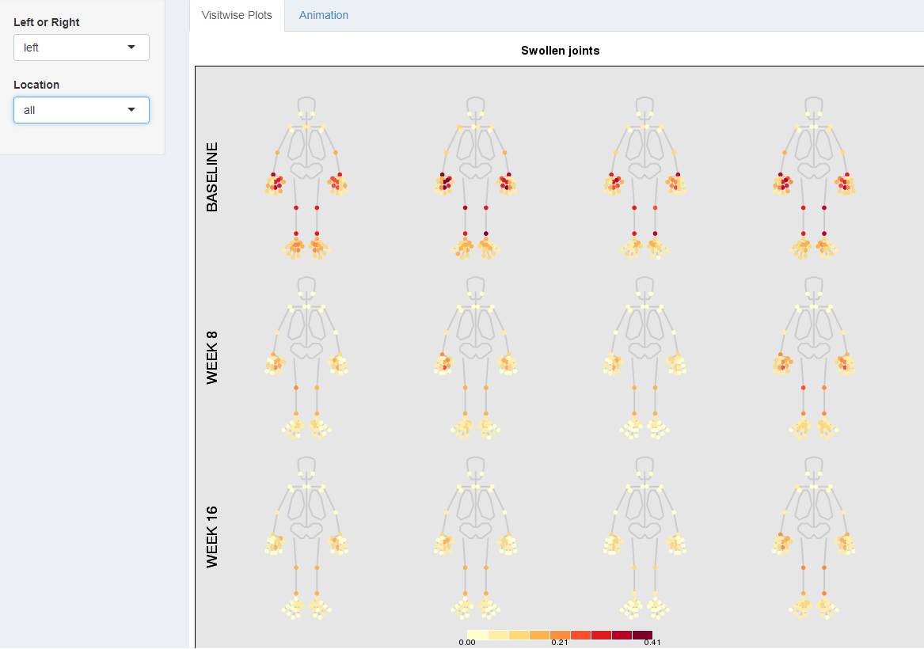
Dynamic Displays @ Novartis
Each column is a treatment cohort
Each row is a separate time point
Heatmap shows proportion of patients with swelling at that particular joint
  Darker color, the higher the proportion
  Summaries calculated and colored on the fly
Over time swelling decreases

Slide 19
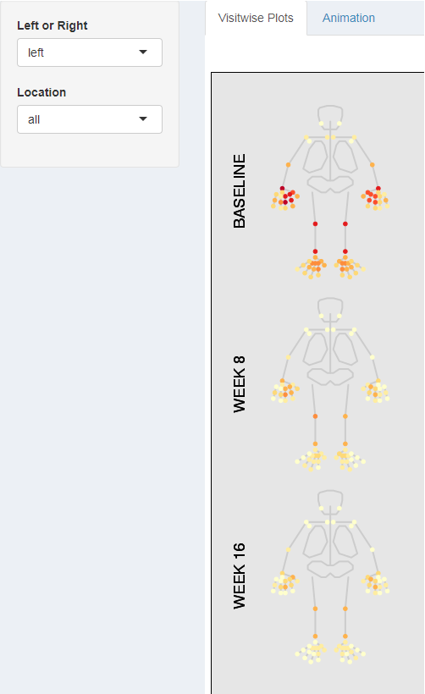
Dynamic Displays @ Novartis
Zoom into one treatment group
Same as previous slide
Notice the drop down menus
  Can drill down to explore a particular part of the body for greater detail
  Select either the left or right
  Explore clavicle, arm, hand, leg, foot, etc

Slide 20
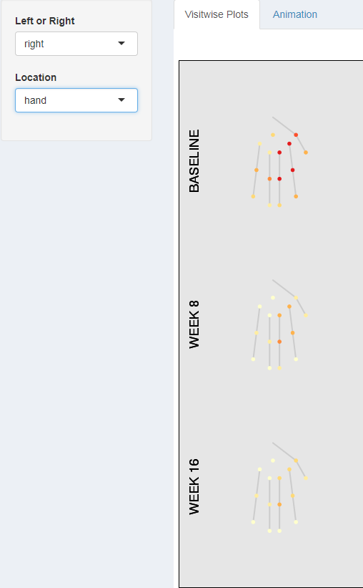
Dynamic Displays @ Novartis
Zoom into one treatment group
Same as previous slide
Notice the drop down menus
  Can drill down to explore a particular part of the body for greater detail
  Select either the left or right
  Explore clavicle, arm, hand, leg, foot, etc
Explore the Right Hand

Slide 21
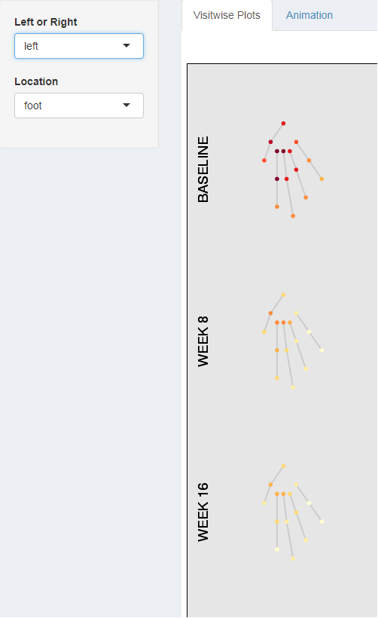
Dynamic Displays @ Novartis
Zoom into one treatment group
Same as previous slide
Notice the drop down menus
  Can drill down to explore a particular part of the body for greater detail
  Select either the left or right
  Explore clavicle, arm, hand, leg, foot, etc
Explore the Left Foot

Slide 22
Dynamic Displays @ Novartis
Credit: Matthew Brierley, Yu Han, Yingbo Wang
Clinical trials produce a great deal of data
Often the statisticians focus on summary level information
...but the clinicians want to focus on patient level information
Challenges: Over 50 separate SAS data tables produced per trial
  Navigation from one static table to another
  Clinicians want to “see” what is going on in their data
Teams often want to perform post hoc exploration of subgroups
  If not defined ahead of time, this turn around takes 1 – 2 wks!
  This leads to more questions and cycle repeats itself
Note: This next App was written for an trial in oncology
  All data are simulated

Slide 23
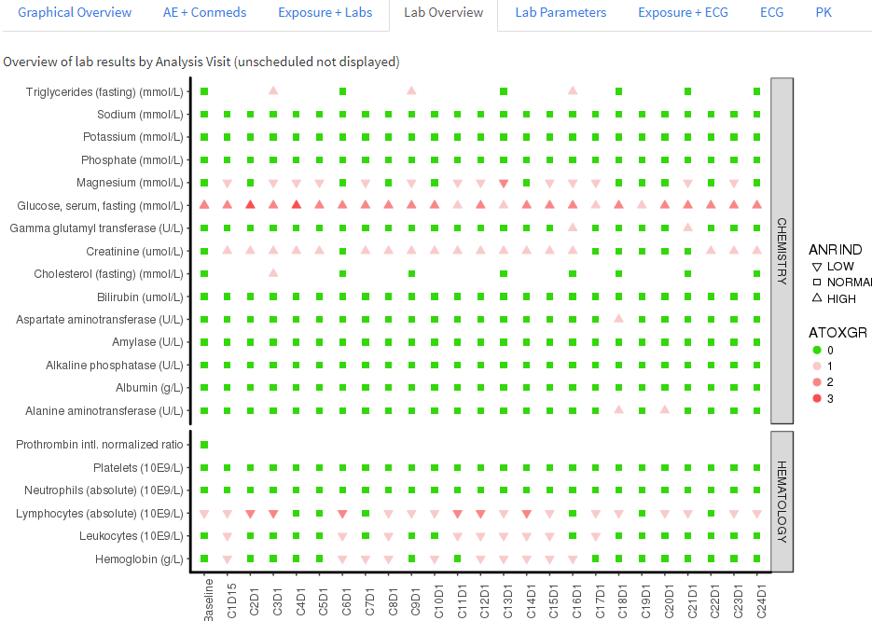
Dynamic Displays Using R - Shiny

Slide 24
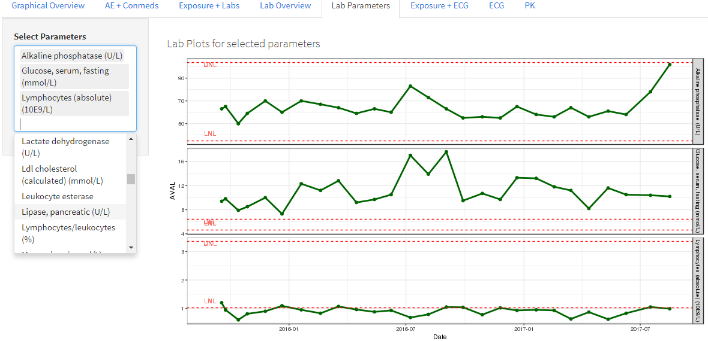
Dynamic Displays Using R - Shiny
Explore all lab parameters for each patient over time (add / subtract)
Red lines represent the upper / lower limits of normal
Can easily see where values fall outside the normal ranges

Slide 25
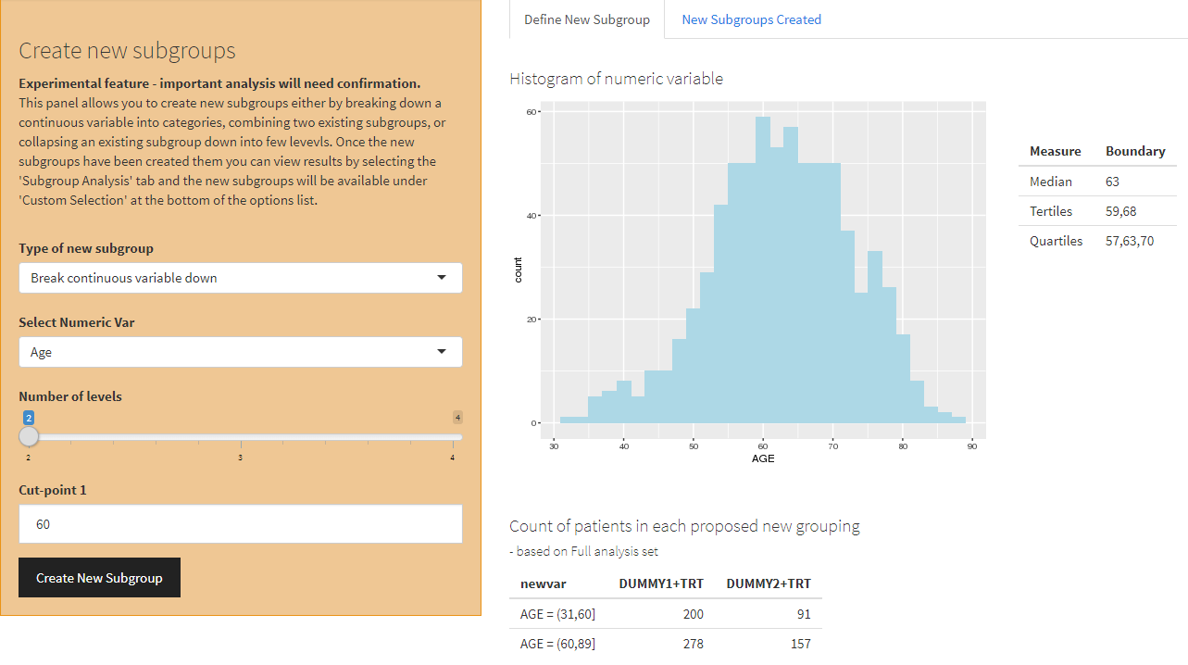
Dynamic Displays @ Novartis
Credit: Matthew Brierley, Yu Han, Yingbo Wang, video (Xiao Ni)
Following video shows a dynamic creation of subgroups with ability to assess efficacy estimates in real time using trial statistical models

Slide 26
Conclusion
It is a great time to be a statistician!
To be successful, you have to be more than just a statistician
  Show statistical leadership by knowing your data and engaging teams
Another way to show leadership is to provide high quality, intuitive graphics
  Graphics Cheat Sheet is a valuable tool to enhance your deliverables
  Enhance understanding with use of good graphical principles
R – Shiny is another way to display your data and engage your teams
  Static tables, listings and figures only get you so far
  Novartis is heavily investing in this technology to develop interactive tools
    Goal is to scale the use of R – Shiny across the portfolio
    Provided two examples out of dozens
When you have more engaged teams, senior management support and statistical colleagues saying that they are having fun with Shiny...
  That is the ultimate win – win!!

Slide 27
Thank You!
Douglas Robinson
Global Head Biomarkers and Diagnostics Biometrics
Advanced Visual Analytics Lead
Clinical Development and Analytics
Novartis Pharmaceuticals
douglas.robinson@novartis.com

